Slide 1
DOM(Document Object Model)
Presented by: Nabin Jamkatel

Slide 2
Introduction
JavaScript arranges objects in a Document Object Model or DOM.
The DOM defines the logical structure of objects and the way an object is accessed and manipulated.
The document object model can be thought of as a hierarchy moving from the most general object to the most specific.
The HTML DOM defines a standard set of objects for HTML, and a standard way to access and manipulate HTML documents

Slide 3
All HTML elements, along with their containing text and attributes, can be accessed through the DOM.
The contents can be modified or deleted, and new elements can be created.
• The HTML DOM is platform and language independent

Slide 4
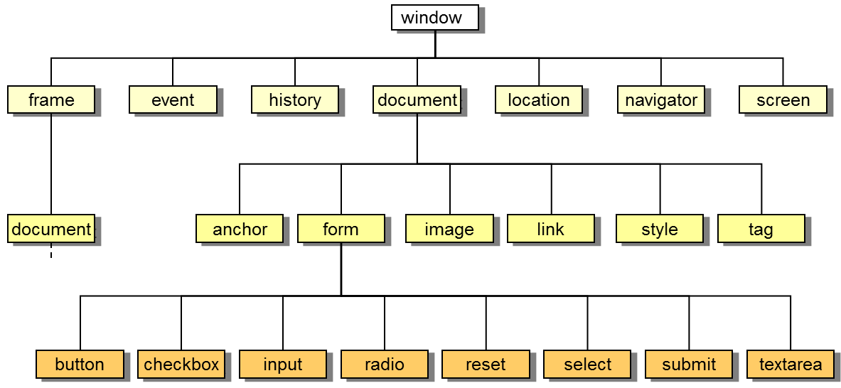
Document Object Model

Slide 5
HTML DOM Objects
Anchor object
Document object
Event object
Form and Form Input object
Frame, Frameset, and IFrame objects
Image object etc

Slide 6
DOM Hierarchy
The topmost object in the hierarchy is the window object, which contains the other objects in the list, such as the current frame, history list, and the Web page document.
The Web page document contains its own set of objects, including links, anchors, and forms.
Within each form are form objects, such as input boxes, radio buttons, or selection lists.

Slide 7
Managing Events
An event is a specific occurrence within the Web browser. For example:
opening up a Web page
positioning the mouse pointer over a location on that page
Events are an important part of JavaScript programming, you can write scripts that run in response to the actions of the user, even after the Web page has been opened.

Slide 8
OnLoad & OnUnload
<html>
<head>
<title>Hello/Goodbye page</title>
<script type="text/javascript">
function Hello()
{ globalName=prompt("Welcome to my page. " + "What is your name?","");
}
function Goodbye() {
alert("So long, " + globalName + ome back real soon.");
}
</script>
</head>

Slide 9
<body onload="Hello();" onunload="Goodbye();">
<p>Whatever text appears in the page.</p>
</body>
</html>

Slide 10
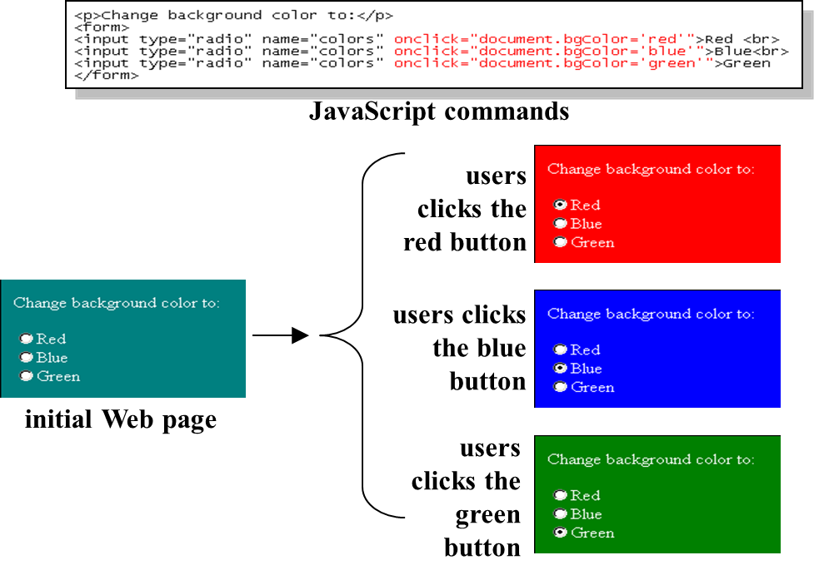
Using the Onclick Event Handler

Slide 11
Windows Example
<html>
<head>
<title> Fun with Buttons </title>
<script type="text/javascript">
function Help(){
var OutputWindow =
window.open("", "", "status=0,menubar=0,height=200,width=200");
OutputWindow.document.open();

Slide 12
OutputWindow.document.write("This might be a context-" +
"sensitive help message, depending on the " +
"application and state of the page.");
}
</script>
</head>
<body>
<form id="ButtonForm">
<p> <input type="button" value="Click for Help"
onclick="Help();" /> </p>
</form>
</body>
</html>

Slide 13
Events Initiated by the User During Data Entry

Slide 14
getElementById()
<html>
<head>
<script type="text/javascript">
function getElement() {
var x=document.getElementById("myHeader");
alert("I am a " + x.tagName + " element"); }
</script>
</head>
<body>
<h1 id="myHeader" onclick="getElement()">Click to see what element I am!</h1>
</body>
</html>

Slide 15
getElementsByName()
<html>
<head>
<script type="text/javascript">
function getElements() {
var x=document.getElementsByName("myInput")
alert(x.length + " elements!")
}
</script>
</head>

Slide 16
<body>
<input name="myInput" type="text" size="20"><br />
<input name="myInput" type="text" size="20"><br />
<input name="myInput" type="text" size="20"><br />
<br />
<input type="button" onclick="getElements()" value="How many elements named
'myInput'?">
</body>
</html>

Slide 17
Return the innerHTML of the first anchor in a document
<html>
<body>
<a name="first">First anchor</a><br />
<a name="second">Second anchor</a><br />
<a name="third">Third anchor</a><br />
<br />
InnerHTML of the first anchor in this document:
<script type="text/javascript">
document.write(document.anchors[0].innerHTML)
</script>
</body>
</html>

Slide 18
Access an item in a collection
<html>
<body>
<form id="Form1" name="Form1">
Your name: <input type="text">
</form>
<form id="Form2" name="Form2">
Your car: <input type="text">
</form>

Slide 19
<p>
To access an item in a collection you can either use the number or the name of the item:
</p>
<script type="text/javascript">
document.write("<p>The first form's name is: " + document.forms[0].name + "</p>")
document.write("<p>The first form's name is: " + document.getElementById("Form1").name
+ "</p>")
</script>
</body>
</html>

Slide 20
Server-Side and Client-Side Validation

